Slide 1
3D Object Mesh Recognition As An Input To A Procedural Audio Game Engine
Thesis Proposal
MMI 813 – Master’s Research Project
Ashay Dave

Slide 2
3D Object Mesh Recognition As An Input To A Procedural Audio Engine
Contents:
Theme and Background
Objective
Aims
Research Questions
Timeline
References

Slide 3
Jargon
3D Object Mesh Recognition As An Input To A Procedural Audio Engine
Procedural Audio
Procedural audio (PA) is sound that is generated at runtime using code, rather than using a WAV or MP3 sound file [1]. It creates sound effects that the player hears on the fly, based on a set of pre-defined behaviors.
It is a different approach to traditional sound design, where a sound class is modeled as a mathematical process [2].
PA models are simpler and more computationally efficient, using algorithms to generate sound based on static and temporal control variables, usually accompanied by random noise to span variations in synthesis [2,3].
Notes:
1 & 2. The job of the sound designer is to record, synthesize, and process audio stimuli for immersive mediums such as film, video games, and virtual environments in such a way that complements visual or other stimuli. The current paradigm typically involves scanning through extensive audio databases for a set of recorded sounds of a sound class C and preprocessing them to fit a project’s needs [1]. This process is time-consuming and may result in a lack of realism if suitable sounds cannot be found or processed. Storage limitations may also be a problem, arising from the need for a large number of distinct recordings for a highly variable sound class, especially in interactive media such as video games and virtual environments where sound events are influenced by the user’s context.
A procedural audio system can change the pitch, volume, timbre, or rhythm of a sound or music track based on the game variables, such as the player's speed, health, location, or mood. Procedural audio can also generate sounds and music from scratch using mathematical models, such as waveforms, noise, filters, or envelopes. Procedural audio can be implemented using code, middleware, or dedicated tools.
3. Despite its advantage in computational efficiency, current classical PA models still synthesize sounds of lower quality compared to using real samples or physical modeling synthesis — a primary reason why they are not yet in standard use in sound design. And it’s usually quite complicated to implement something without programming knowledge.

Slide 4
Jargon
3D Object Mesh Recognition As An Input To A Procedural Audio Engine
Use of Procedural Audio in Games
No Man’s Sky -> VocAlien engine (used to synthesize vocalizations of unique creatures)
Two Dots -> Synthesizing sounds through PureData to save disk space and RAM.
Grand Theft Auto V – Audio synthesis toolkit (called AMP)
Borderlands 3 – Modular weapons system
Sim Cell by Leonard Paul – Granular Synthesis in real time
Unreal Engine’s MetaSounds – DSP Graph Generation for Sound Sources.
Notes:
GTA V – Footsteps, bicycle sounds, air conditioning sounds, collisions, environmental, NPC voices, etc.
Borderlands – The audio time built a collection of sound effects using various characteristics based on different components of a weapon. For example, a snub nose barrel and a long barrel would each impact the sonic characteristics of a pistol, where all other aspects could be the same. Therefore, the team took a modular approach so that each piece of a weapon would come together to create the overall weapon sound.
A system like this has its advantages; creating bespoke sound effects from scratch for every possible weapon combination in the game would not only be incredibly time consuming and workload intensive, but also require a lot of memory overhead.
In order to create this modular system, the team recorded hundreds of different types of weapon assets that they would then design and mix together in a potential pool of combinations. The challenge was that every weapon element eligible to be combined needed to blend with the other sounds in a natural way.
For example, a procedural audio system can change the pitch, volume, timbre, or rhythm of a sound or music track based on the game variables, such as the player's speed, health, location, or mood. Procedural audio can also generate sounds and music from scratch using mathematical models, such as waveforms, noise, filters, or envelopes. Procedural audio can be implemented using code, middleware, or dedicated tools.

Slide 5
Jargon
3D Object Mesh Recognition As An Input To A Procedural Audio Engine
Adaptive Music Systems
Adaptive music addresses the “linear” use of music - music is directly tied to the current level and/or game state. With linearly composed music, the music begins playing through a musical piece when the associated level is loaded. [4]
When the game soundtrack reacts to player’s interactions, we call such technique adaptive audio [5].
There are different techniques in implementing adaptive audio, such as Vertical layering, Horizontal re-sequencing, generative networks, and organization and segments variation, each with a separate architecture.
Notes:
Adaptive music is generally a piece of music composed in a way that, when broken in sections creates unique compositions, so more like derivations of one track. The track is broken into multiple groups of instruments and arrangements which results in multiple arrangements of one track.
Vertical - The vertical layering technique is the segmentation of an audio in individual layers, each composed by one or more instruments/sound effects. When playing a song using this approach, the user can activate or deactivate any layer, introducing or removing the desirable sounds according to in-game events. Eg -> calm state, enemies come, action/danger state, music changes.
Horizontal - Horizontal re-sequencing is a technique used to reproduce queued audio tracks, like a playlist. Each track can have a different duration, long tracks or short fragments, as long as they can musically connect with each other. Each track fragment is played according to the current state of the game. As an example, consider a game character that is moving away from a safe area, like a town, and entering a dangerous area, like a forest or a cave. Using the horizontal re-sequencing technique, the audio can transition along with the character. Eg -> completely based on game state.
Organization and segments variation – To avoid repetition of sounds, there are subtle changes in the volume, pitch, timbre/frequency to randomize reproduction. Guns as an example.
Generative audio – speaks for itself. Multiple works that utilize generative adversarial networks and study generative music for video games. [6,7,8

Slide 6
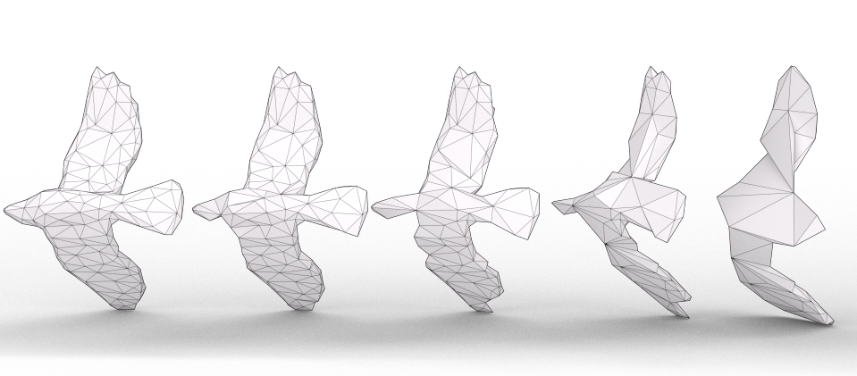
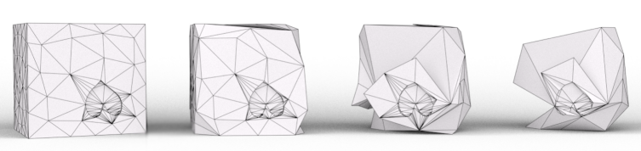
Jargon
3D Object Mesh Recognition As An Input To A Procedural Audio Engine
3D Objects & Meshes
A 3D object is a physical representation of an object inside a 3D space, such as a video game. To represent a 3D object, it is comprised of polygons that provide an efficient non-uniform representation of an object or space.​
These polygons (often triangles) come together to make something called a “mesh”.
Notes:
A mesh is made up of polygons, often triangles, that include vertices and edges. A mesh provides an efficient non uniform representation of a space. In the context of video games, a mesh would often make up the game objects that make up the virtual world.​

Slide 7
Theme & Background
3D Object Mesh Recognition As An Input To A Procedural Audio Engine
The theme of this research revolves around the intersection of using neural networks, to drive as an input for audio generation in video games.
By integrating 3D object mesh recognition as an input to procedural audio engines, the goal is to pioneer an unexplored approach that enhances player immersion, realism, and the overall quality of audio design in gaming environments.
Long term goal: Contribute towards a procedural audio engine that adapts to the changes in the game’s actual physical environment, a novel method of audio design and implementation for video games.
Notes:
The field of generative and procedural audio in interactive virtual environments is relatively unexplored but as the capabilities of machine learning and artificial intelligence continue to be developed, there will be improved methodologies to implement sonic experiences in video games. With this research, driving procedural/generative audio and music through contextual clues and actors using physical characteristics of a 3D object inside the scene will be developed. Video game developers would be able to use a procedural audio engine that adapts to changes in the scene’s mesh data. This would ideally be a stepping stone towards a novel method of sound designing for video games – which is the long term goal of this thesis, contributing to the evolution of interactive and immersive audio experiences in video games or visual media. Beyond the immediate scope of the thesis, the long-term vision is to influence industry practices and inspire further research in the intersection of artificial intelligence, procedural audio, and game design.

Slide 8
Objective
3D Object Mesh Recognition As An Input To A Procedural Audio Engine
The primary objective is to develop, implement, and evaluate a system that seamlessly integrates a 3D object mesh recognition neural network that drives a procedural audio engine within the Unity game development environment.

Slide 9
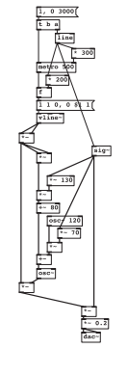
Aim 1
3D Object Mesh Recognition As An Input To A Procedural Audio Engine
Developing an integrated system to perform mesh recognition with a procedural audio engine in Unity
To run a neural network in Unity, we need a couple of tools:
Decide neural network to use for 3D object mesh recognition.
Convert model to ONNX (Open Neural Network Exchange) format.
Unity Sentis or Barracuda (now deprecated).
To generate sound:
Build a procedural audio engine using PureData.
Integrate PureData with Unity using LibPD or uPD, wrappers that integrate PureData into Unity.
Test the system for real-time implementation and constantly measure performance statistics to determine feasibility. Optimize if necessary for evaluation.
Notes:
Pure Data is a visual programming language that allows users to generate audio though graph-like ‘patches’ using a series of built-in oscillators, filters, and effects. This allows the composers to script audio behavior right inside of Pure Data, using parameters that change the audio output at runtime based on gameplay.
ONNX is an open format built to represent machine learning models. ONNX defines a common set of operators - the building blocks of machine learning and deep learning models - and a common file format to enable AI developers to use models with a variety of frameworks, tools, runtimes, and compilers.
Sentis -> To import ONNX file into Unity.

Slide 10
Aim 1
3D Object Mesh Recognition As An Input To A Procedural Audio Engine
Developing an integrated system to perform mesh recognition with a procedural audio engine in Unity
3D Object Mesh Recognition neural networks:
MeshCNN, a convolutional neural network designed specifically for triangular meshes [9].
3D Object Recognition using X3D and Deep Learning [10].
Deep Neural Network for 3D Shape Classification Based on Mesh Features [11].

Slide 11
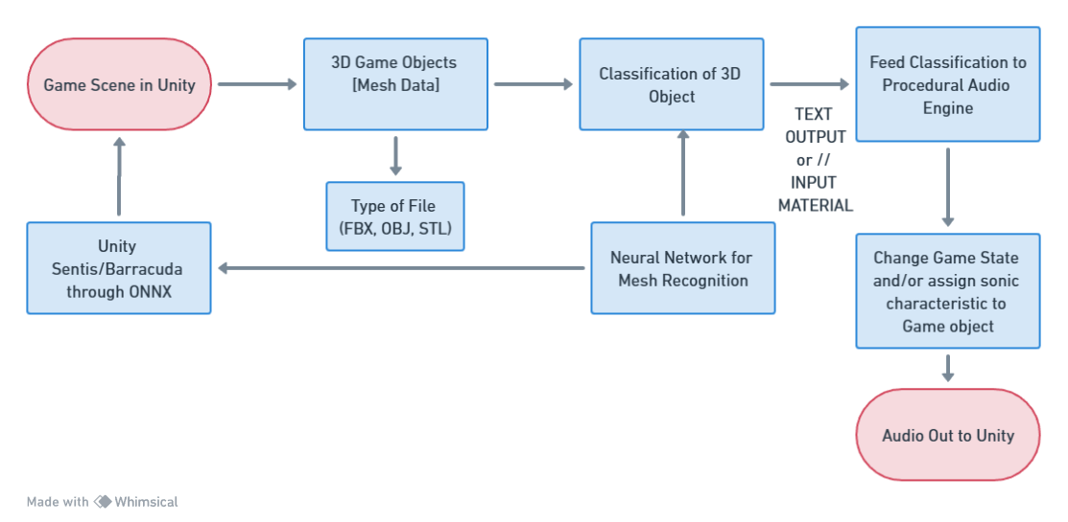
Aim 1
3D Object Mesh Recognition As An Input To A Procedural Audio Engine
Flow diagram:

Slide 12
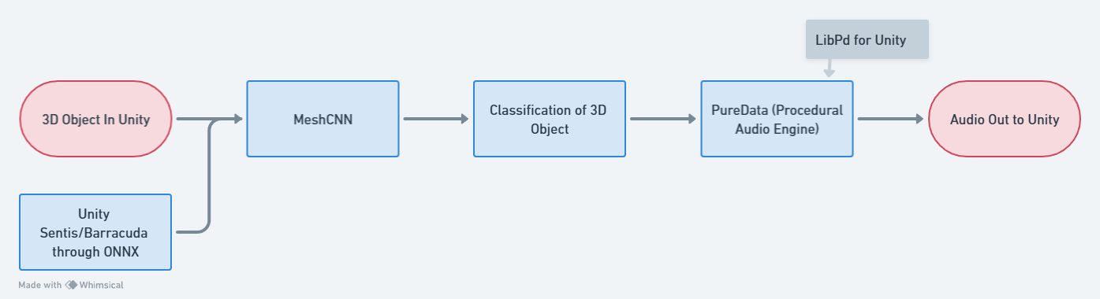
Aim 1
3D Object Mesh Recognition As An Input To A Procedural Audio Engine
Simplified example flow:

Slide 13
Aim 2
3D Object Mesh Recognition As An Input To A Procedural Audio Engine
To assess the impact of the 3D object mesh recognition and procedural audio integration on player immersion and engagement.
This is a hypothesis driven aim, that involves evaluating and analyzing the effectiveness of the integrated system by conducting a comprehensive user experience analysis.
The structure of the study will involve creating two iterations of a simple interactive game using the Unity game engine that includes a few 3D objects to test our hypothesis. One iteration of the game will use the integrated system, and one that uses traditional sample based audio using Unity’s native audio engine.
Notes:
An experimental study will be set up to gather quantitative and perhaps certain qualitative data on player experiences with the integrated system.

Slide 14
Aim 2
3D Object Mesh Recognition As An Input To A Procedural Audio Engine
To assess the impact of the 3D object mesh recognition and procedural audio integration on player immersion and engagement.
Steps:
Create a simple interactive game involving at least 5 game objects with recognizable mesh features.
Make two iterations of the game, one with the integrated system of the mesh recognition and procedural audio engine, and one with traditional sample based audio using Unity’s native audio engine.
Before and after asking a participant to play the game, a questionnaire referenced from a study by Prechtl. A [12] would be devised to measure the player’s responses on immersivity.
Analysis of the A/B test would be carried out and a mean immersivity and realism variable will be calculated (μ).
Notes:
An experimental study will be set up to gather quantitative and perhaps certain qualitative data on player experiences with the integrated system.

Slide 15
Aim 2
3D Object Mesh Recognition As An Input To A Procedural Audio Engine
To assess the impact of the 3D object mesh recognition and procedural audio integration on player immersion and engagement.
Independent variables
Integration of 3D Object Mesh Recognition and Procedural Audio Integration.
Dependent variables
Immersivity.
Realism.
Responsiveness.
Engagement.
Notes:
An experimental study will be set up to gather quantitative and perhaps certain qualitative data on player experiences with the integrated system.
Immersivity:
Definition: The perceived sense of being fully engaged or immersed in the virtual environment.
Measurement: This can be measured using subjective assessments, such as participant self-reports or rating scales that capture the degree of immersion experienced during gameplay.
Realism:
Definition: The degree to which the gaming experience is perceived as lifelike or authentic.
Measurement: Realism can be assessed through subjective evaluations by participants, considering factors such as the believability of in-game sounds and their connection to recognized 3D objects.
Responsiveness:
Definition: The speed and accuracy with which the procedural audio engine adapts to player interactions and the recognition of 3D objects.
Measurement: Responsiveness can be quantified by analyzing the time it takes for the audio system to generate appropriate responses to recognized objects and player actions.
Engagement:
Definition: The level of interest, involvement, and captivation experienced by players during gameplay.
Measurement: Engagement can be assessed through a combination of subjective reports from participants and objective measures such as gameplay metrics, player behaviors, and physiological responses.

Slide 16
Aim 2
3D Object Mesh Recognition As An Input To A Procedural Audio Engine
To assess the impact of the 3D object mesh recognition and procedural audio integration on player immersion and engagement.
Hypothesis: Integrating 3D object mesh recognition as an input to a procedural audio engine in games will significantly enhance immersivity and realism. By dynamically linking in-game sounds to recognized 3D objects, the interactive experience is expected to be more responsive and engaging, providing players with a heightened sense of presence and a deeper connection to the virtual environment.
H0: μ1 = μ2 (There is no significant difference in immersivity and realism)
H1: μ1 ≠ μ2 (There is a significant difference in immersivity and realism)
Notes:
The null hypothesis (H0) would be that there is no significant enhancement in immersivity and realism resulting from integrating 3D object mesh recognition as an input to a procedural audio engine in games. In other words, the dynamic linking of in-game sounds to recognized 3D objects does not lead to a statistically significant difference in the responsiveness and engagement of the gaming experience compared to traditional sound design methods.
The alternative hypothesis suggests that integrating 3D object mesh recognition as an input to a procedural audio engine in games significantly enhances immersivity and realism. The dynamic connection between in-game sounds and recognized 3D objects is expected to result in a statistically significant improvement in the responsiveness and engagement of the gaming experience, providing players with a heightened sense of presence and a deeper connection to the virtual environment.
U1 represents mean immersivity and realism in a scene without our integrated system and u2 represents with.

Slide 17
Research Question(s)
3D Object Mesh Recognition As An Input To A Procedural Audio Engine
To what extent can neural net approaches to mesh identification be used to drive a procedural audio system in a game engine?
How does the integration of a procedural audio system, driven by neural net-based mesh identification, contribute to player immersion and engagement in interactive gaming environments?
Notes:
How can the use of neural networks for 3D object mesh recognition facilitate the generation of adaptive and context-aware procedural audio responses that enhance the overall gaming immersion?

Slide 18
Okay, but why?
3D Object Mesh Recognition As An Input To A Procedural Audio Engine
Addressing a fundamental challenge in traditional game or virtual world development – the need for dynamic and context-aware audio experiences that respond to user interactions in real-time.
Dynamic user-driven experiences.
Enhanced immersion, adaptability to various game contexts.
Less manual work.
Exploration of novel game mechanics.
Further avenues of use involving visual media, especially in Augmented Reality.
Notes:
In many game development scenarios, developers indeed possess knowledge about the 3D objects they are working with and often manually assign sounds to these objects. However, this approach has limitations when it comes to handling dynamic and unpredictable player interactions. Players can interact with the game environment in ways unforeseen by developers, leading to a potential mismatch between the assigned sounds and the actual in-game events.
By employing advanced algorithms for real-time recognition of 3D objects, the system gains the capability to dynamically adapt audio responses based on the player's interactions.
Dynamic user driven exp -> The integration allows for audio experiences that are driven by player actions, introducing an element of unpredictability and dynamism. Whether it's manipulating objects, exploring the environment, or engaging in interactions, the audio adapts organically to the player's choices.
Enhanced immersion -> Sounds can be intricately tied to the recognized objects, creating a seamless connection between the virtual environment and the auditory feedback, enhancing the overall sense of presence.
Adaptability -> Whether in open-world exploration, puzzle-solving, or combat scenarios, the procedural audio responds intelligently to the recognized 3D objects, ensuring a contextual and nuanced auditory experience.
Manual work -> While developers may have insights into the objects within a game, manually assigning sounds to every possible interaction can be labor-intensive and challenging to predict comprehensively. 3D object mesh recognition automates this process, alleviating the burden of exhaustive manual sound assignments and providing a more scalable solution.

Slide 19
3D Object Mesh Recognition As An Input To A Procedural Audio Engine
Timeline
Phase | Details | Start | Finish | Aug | Sep | Oct | Nov | Dec | Jan | Feb | Mar
General Research | Browse through papers/publications on state -of -the -art topics of interest | 8/21/23 | 9/15/23
In-Depth Research | Do more in -depth studying around a specific chosen area of research | 9/15/23 | 9/29/23
Project Execution Planning | Understand the current state of the art and it’s “goal state”, then brainstorm projects to help tie the gap | 9/29/23 | 10/06/23
Proposal First Draft | Understand the current state of the art and it’s “goal state”, then brainstorm projects to help tie the gap | 10/06/23 | 10/13/23
Annotated Bibliography | Document previously accomplished work in this area and how it relates | 10/13/23 | 10/20/23
Prepare Technical Requirements | Plan the procedures and tools required for executing the system | 10/20/23 | 11/03/23

Slide 20
3D Object Mesh Recognition As An Input To A Procedural Audio Engine
Timeline
Phase | Details | Start | Finish | Aug | Sep | Oct | Nov | Dec | Jan | Feb | Mar
Test and evaluate neural network models | Start integrating neural network into Unity for testing | 11/10/23 | 12/15/23
Present Proposal to Committee | Make any necessary changes to the project after the presentation | 12/04/23 | 12/04/23
Build Procedural Audio Engine | Using PureData, make a generic procedural audio engine and integrate with Unity | 12/15/23 | 10/22/23
Make interactive game in Unity | Make the game and integrate the system for testing | 12/22/23 | 1/12/24
Conduct Evaluation and Analysis | Perform and analyze user tests through proposed evaluation strategy | 01/12/24 | 02/16/24
Documentation | Put together the final thesis document and enter results for committee review | 02/16/24 | 03/15/24

Slide 21
References
3D Object Mesh Recognition As An Input To A Procedural Audio Engine
[1] How procedural audio brings sounds to life in video games - Blog | Splice [2] Andy Farnell, “An introduction to procedural audio and its application in computer games,” 2007.
[3] Niels Bottcher, “Current problems and future possibilities of procedural audio in computer games,” Journal of Gaming & Virtual Worlds, vol. 5, no. 3, pp. 215–234, Sept. 2013.
[4] C. Plut and P. Pasquier, “Generative music in video games: State of the art, challenges, and prospects,” Entertainment Computing, vol. 33, p. 100337, Mar. 2020, doi: 10.1016/j.entcom.2019.100337.​
[5] K. Collins, “An introduction to the participatory and nonlinear aspects of video games audio,” Essays on sound and vision, pp. 263–298, 2007.
[6] P. E. Hutchings and J. McCormack, “Adaptive Music Composition for Games,” IEEE Trans. Games, vol. 12, no. 3, pp. 270–280, Sep. 2020, doi: 10.1109/TG.2019.2921979.​
[7] A. Gungormusler, N. Paterson-Paulberg, and M. Haahr, “barelyMusician: An Adaptive Music Engine for Video Games,” in Audio Engineering Society Conference: 56th International Conference: Audio for Games, Feb. 2015.​
[8] M. F. Rodrigues and F. R. S. Coutinho, “A Tool to Implement Adaptive Audio Techniques on Unity Games,” in 2021 20th Brazilian Symposium on Computer Games and Digital Entertainment (SBGames), Gramado, Brazil: IEEE, Oct. 21

Slide 22
References
3D Object Mesh Recognition As An Input To A Procedural Audio Engine
[9] Rana Hanocka, Amir Hertz, Noa Fish, Raja Giryes, Shachar Fleishman, and Daniel Cohen-Or. 2019. MeshCNN: A Network with an Edge. ACM Trans. Graph. 1, 1 (February 2019)
[10] H.-S. Kim, M. Won Lee, “3D Object Recog- nition Using X3D and Deep Learning,” presented at the The 25th International Conference on 3D Web Technology, pp. 1–8 (2020 Nov.),
[11] M. Gao, N. Ruan, J. Shi, W. Zhou, “Deep Neural Network for 3D Shape Classification Based on Mesh Feature,” Sensors, vol. 22, no. 18, p. 7040 (2022 Sep.)
[12] A. Prechtl, “Adaptive Music Generation for Computer Games,” (2016)

Slide 23
Thank you! Time for questions!
3D Object Mesh Recognition As An Input To A Procedural Audio Engine

